Slide 1
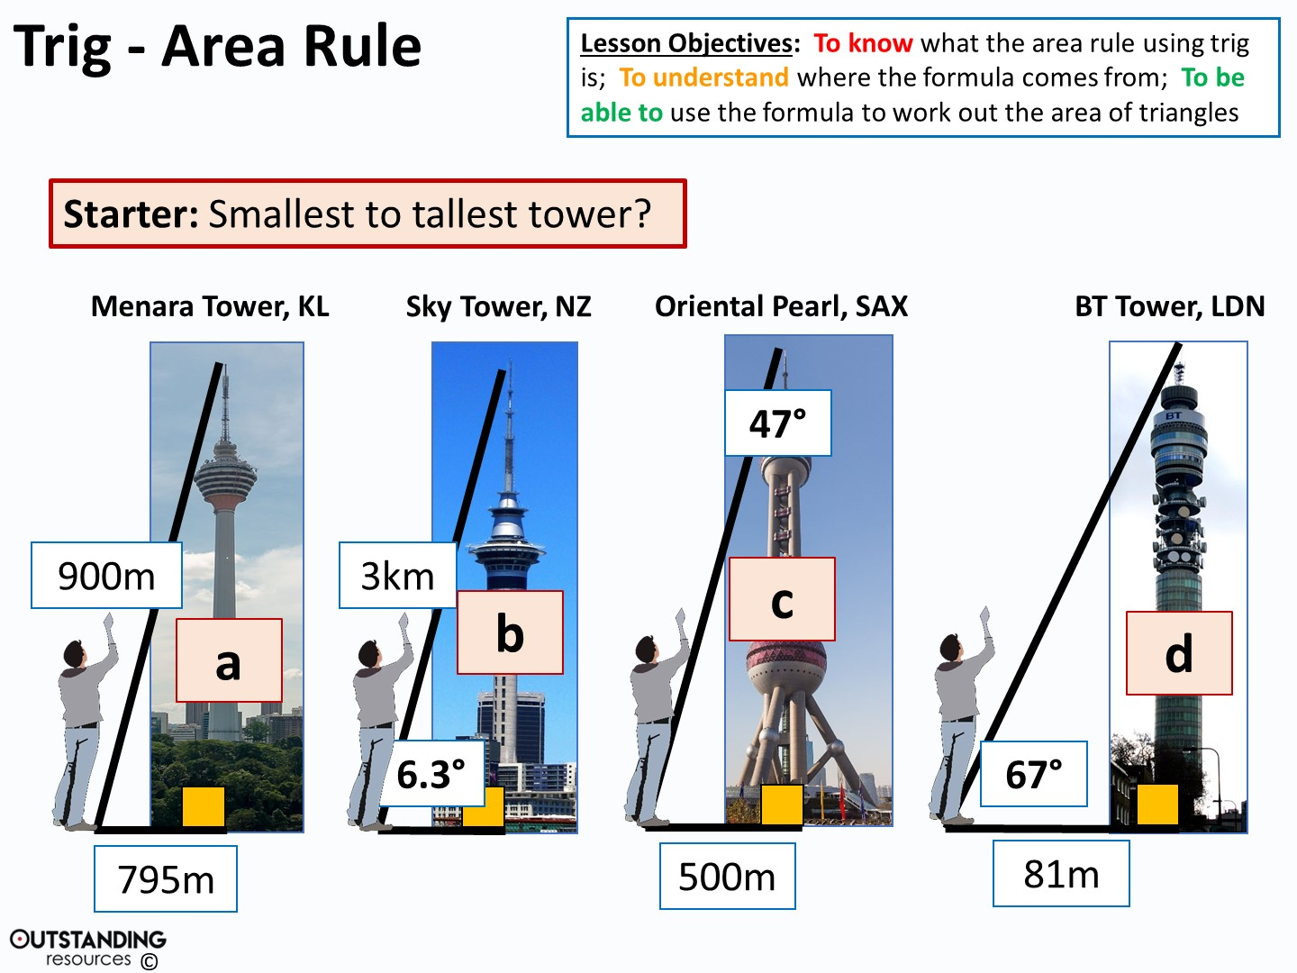
Notes:
Clipart Image: looking up – taken from: https://openclipart.org/detail/202166/aufschauender
Menara Tower - By Photo by CEphoto, Uwe Aranas, CC BY-SA 3.0, https://commons.wikimedia.org/w/index.php?curid=34239888
Sky Tower - By Sids1 from New Zealand - Auckland Sky Tower, CC BY 2.0, https://commons.wikimedia.org/w/index.php?curid=37286267
Oriental Pearl - By Dmitry A. Mottl - Own work, CC BY-SA 4.0, https://commons.wikimedia.org/w/index.php?curid=37902070
BT Tower - By User:Mahlum - Own work, Public Domain, https://commons.wikimedia.org/w/index.php?curid=1738000

Slide 2
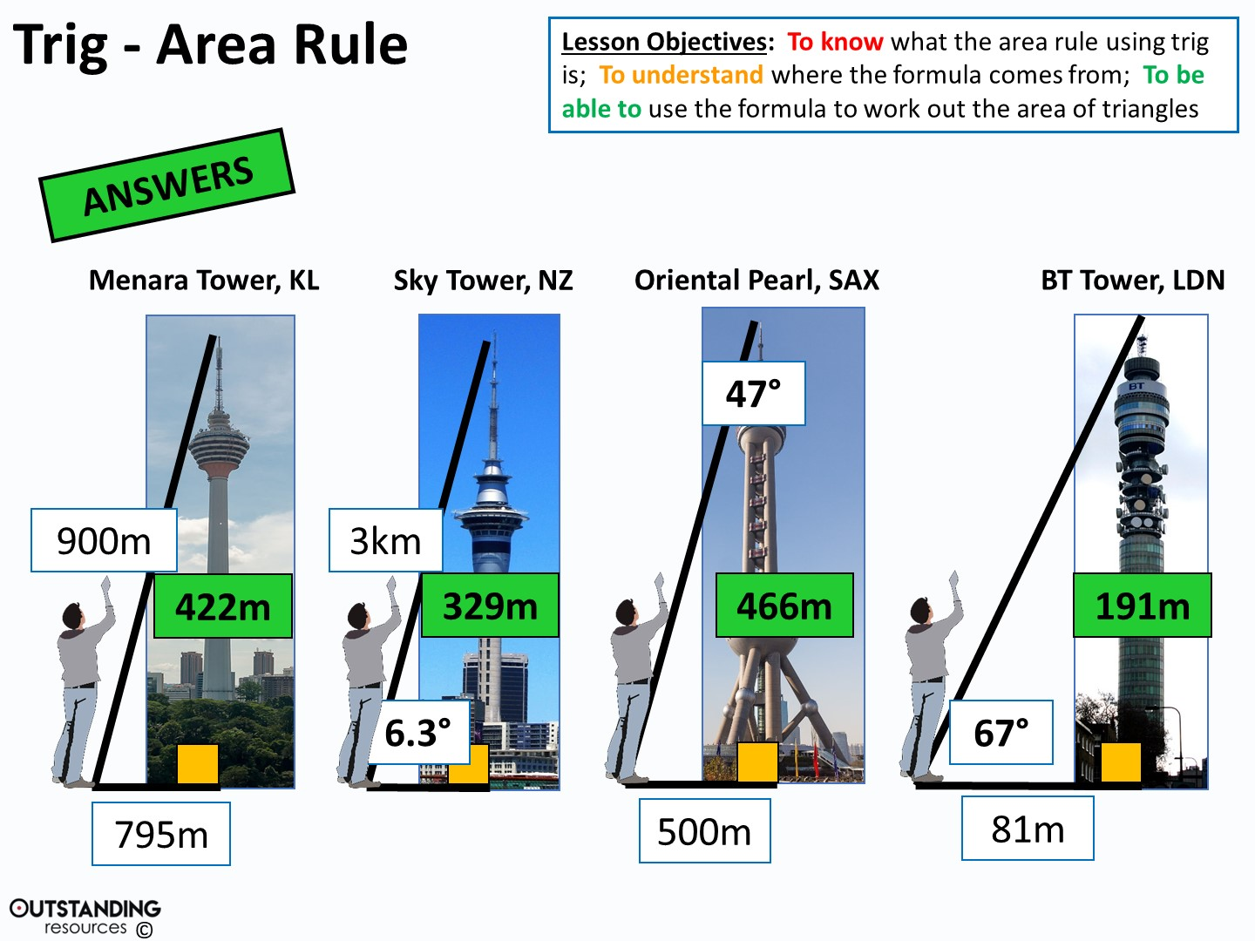
Notes:
Clipart Image: looking up – taken from: https://openclipart.org/detail/202166/aufschauender
Menara Tower - By Photo by CEphoto, Uwe Aranas, CC BY-SA 3.0, https://commons.wikimedia.org/w/index.php?curid=34239888
Sky Tower - By Sids1 from New Zealand - Auckland Sky Tower, CC BY 2.0, https://commons.wikimedia.org/w/index.php?curid=37286267
Oriental Pearl - By Dmitry A. Mottl - Own work, CC BY-SA 4.0, https://commons.wikimedia.org/w/index.php?curid=37902070
BT Tower - By User:Mahlum - Own work, Public Domain, https://commons.wikimedia.org/w/index.php?curid=1738000

Slide 3
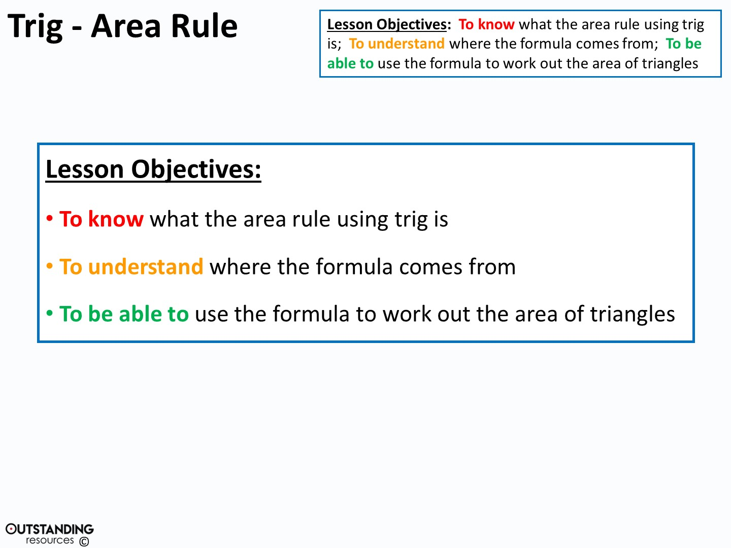

Slide 4
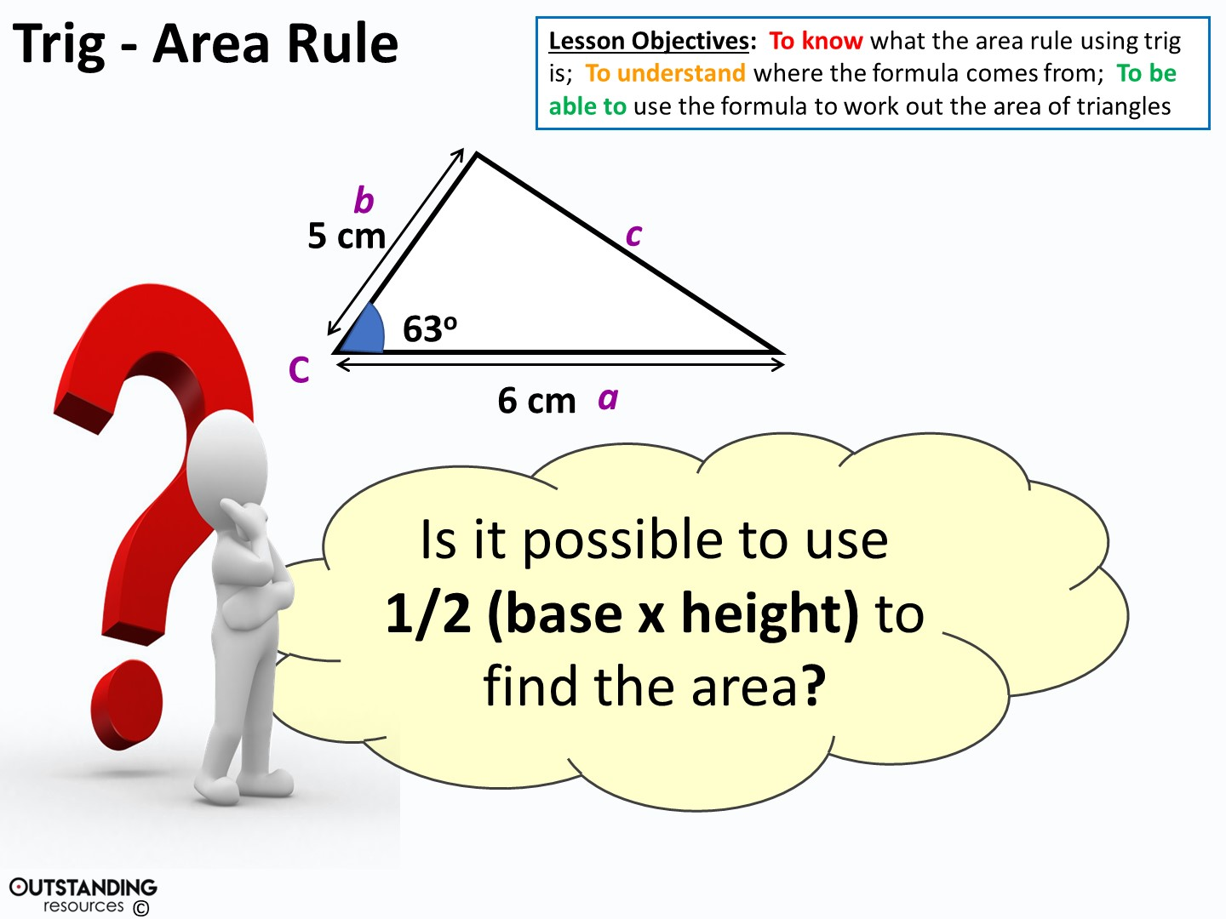
Notes:
Clipart – Questions Clipart #29226: taken from - http://clipartix.com/questions-clipart-image-29226/

Slide 5
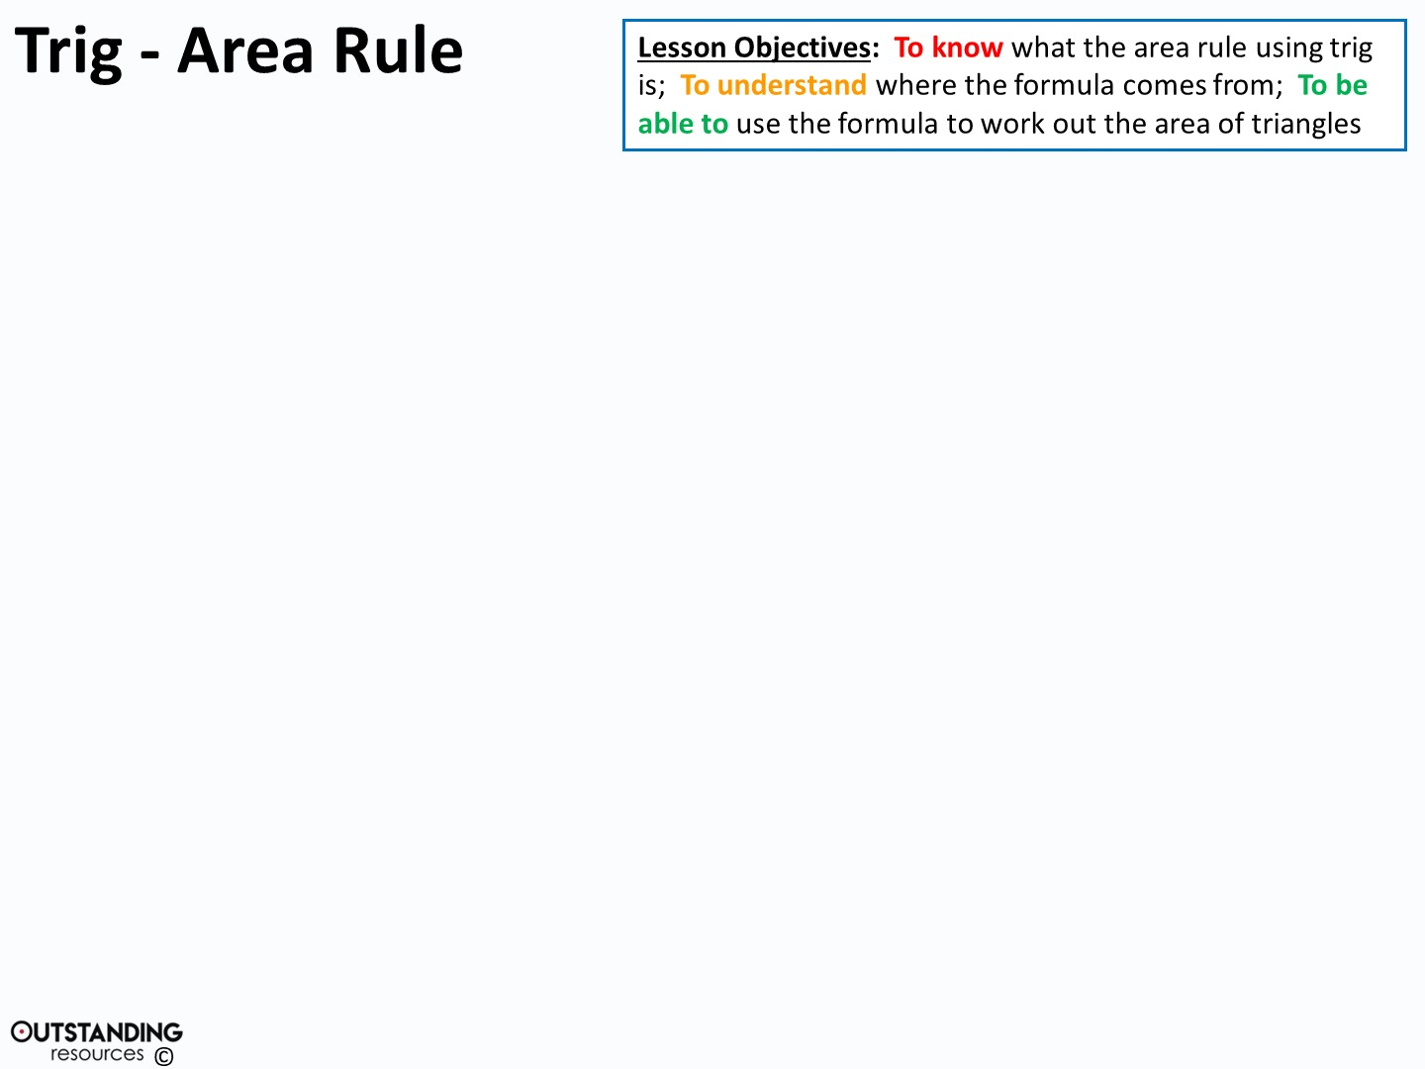
B
a
Area of a triangle
= ½(bh)
c
h
A
C
P
b
In triangle PBC, Sin C =
(xa) h = a sin C (xa)
Substituting this into ½bh gives:
Area = ½ ab.SinC

Slide 6
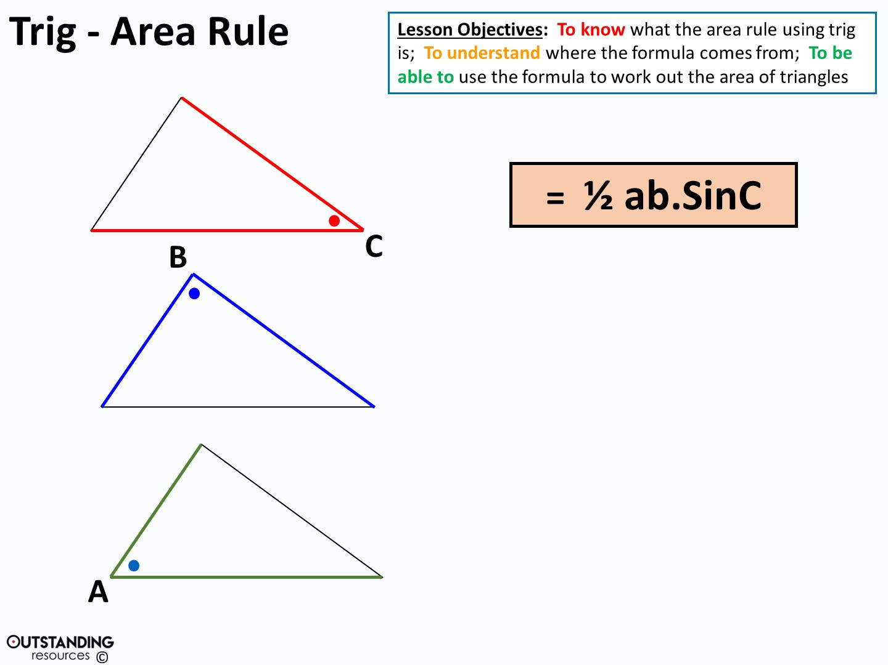
= ½ ac.SinB
= ½ bc.SinA
Notes:
NOTE: However you label the triangle it is ALWAYS the angle and the two sides that make that angle

Slide 7
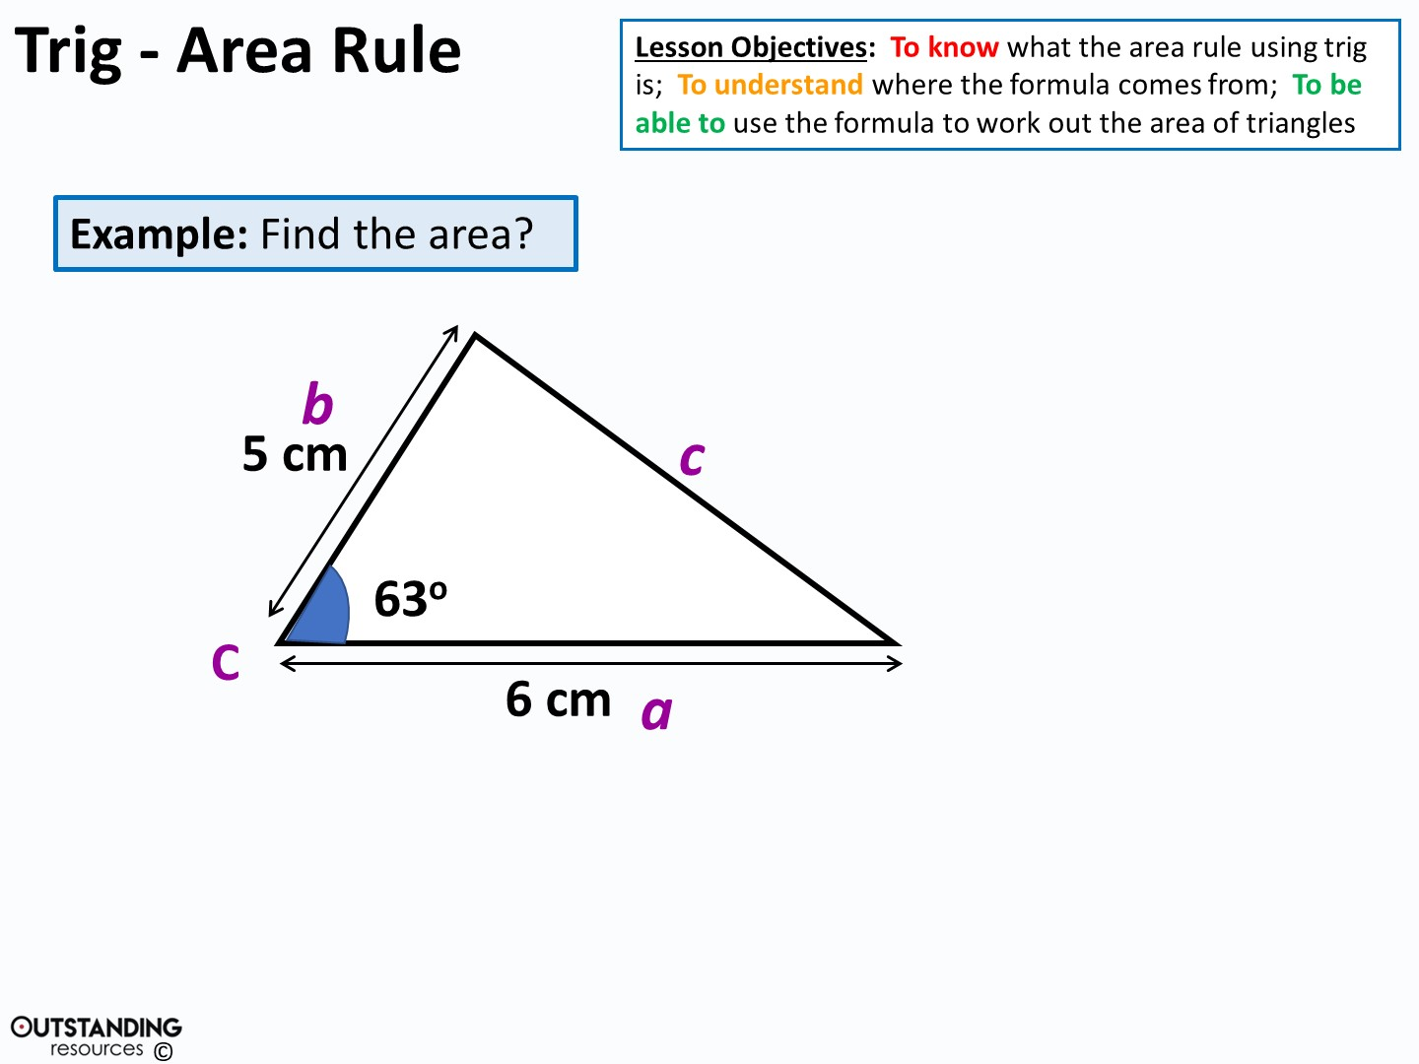
Area = ½ x 5 x 6 x sin 63º
= 13.4 cm²

Slide 8
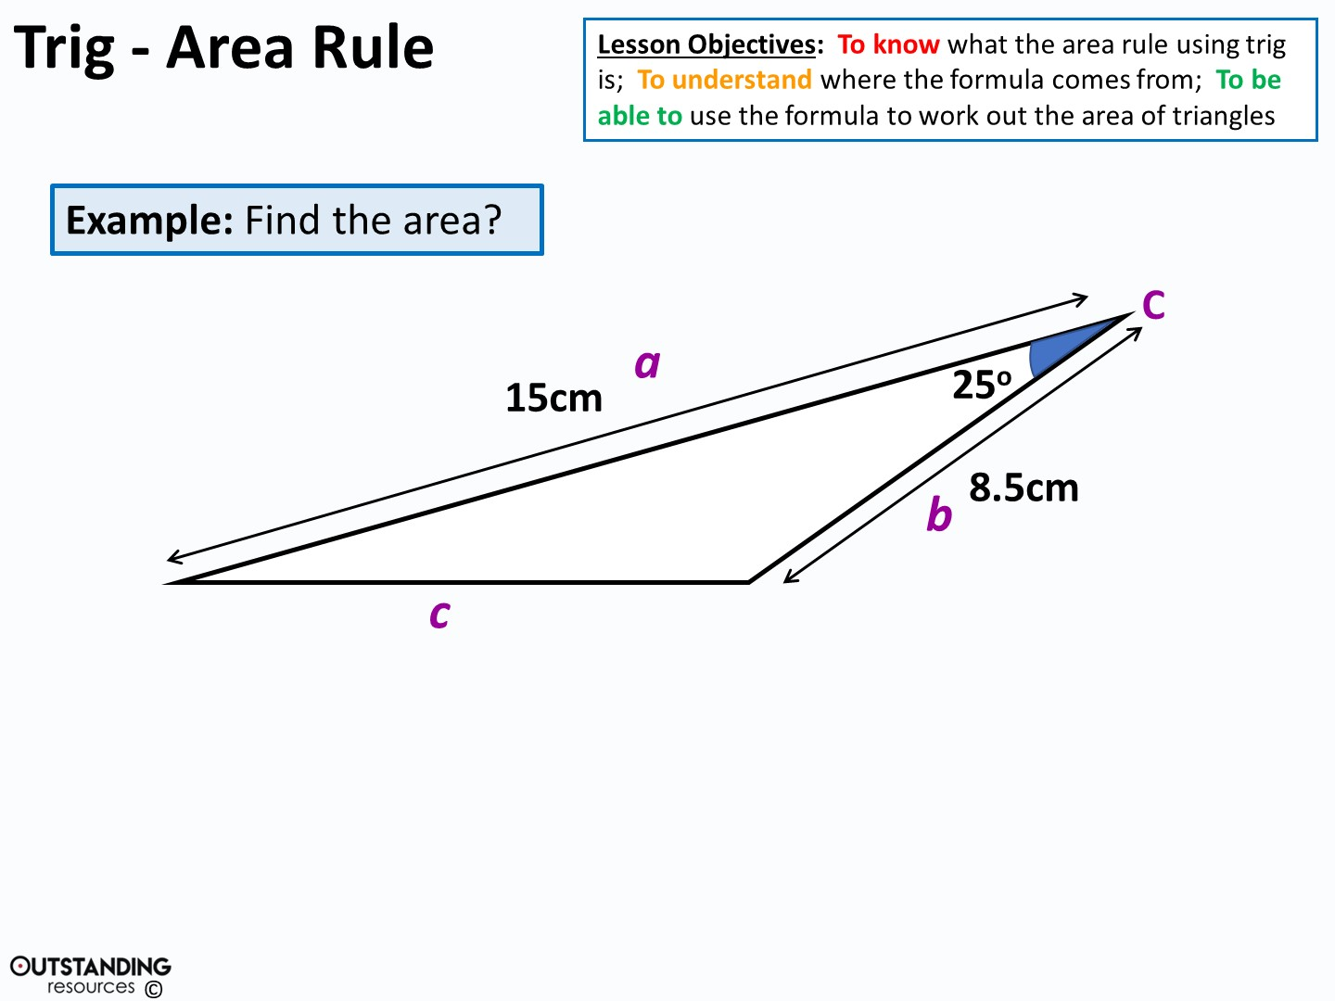
Area = ½ x 15 x 8.5 x sin 25º
= 26.9 cm²

Slide 9
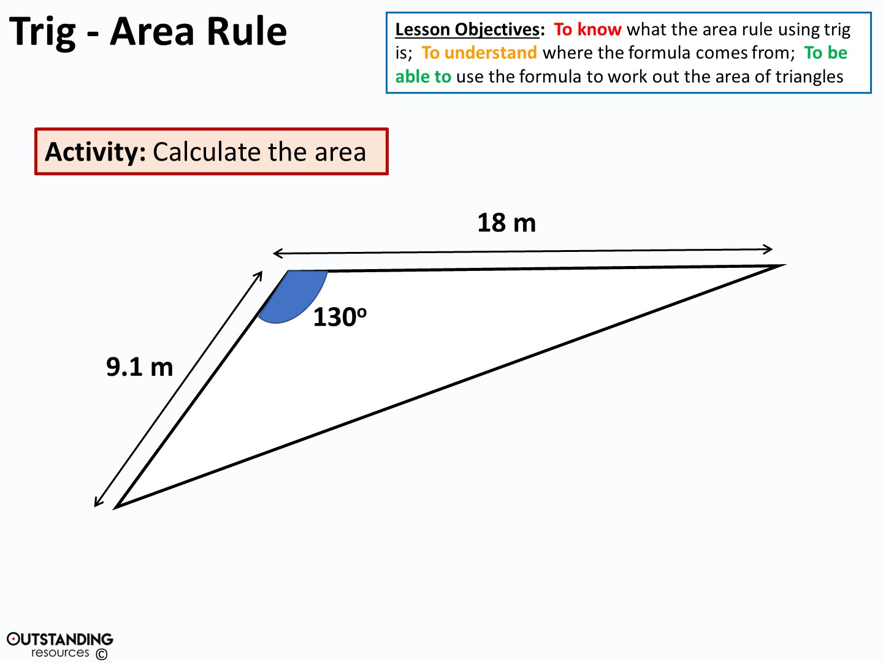
Area = ½ x 9.1 x 18 x sin130º
= 62.7 m²

Slide 10
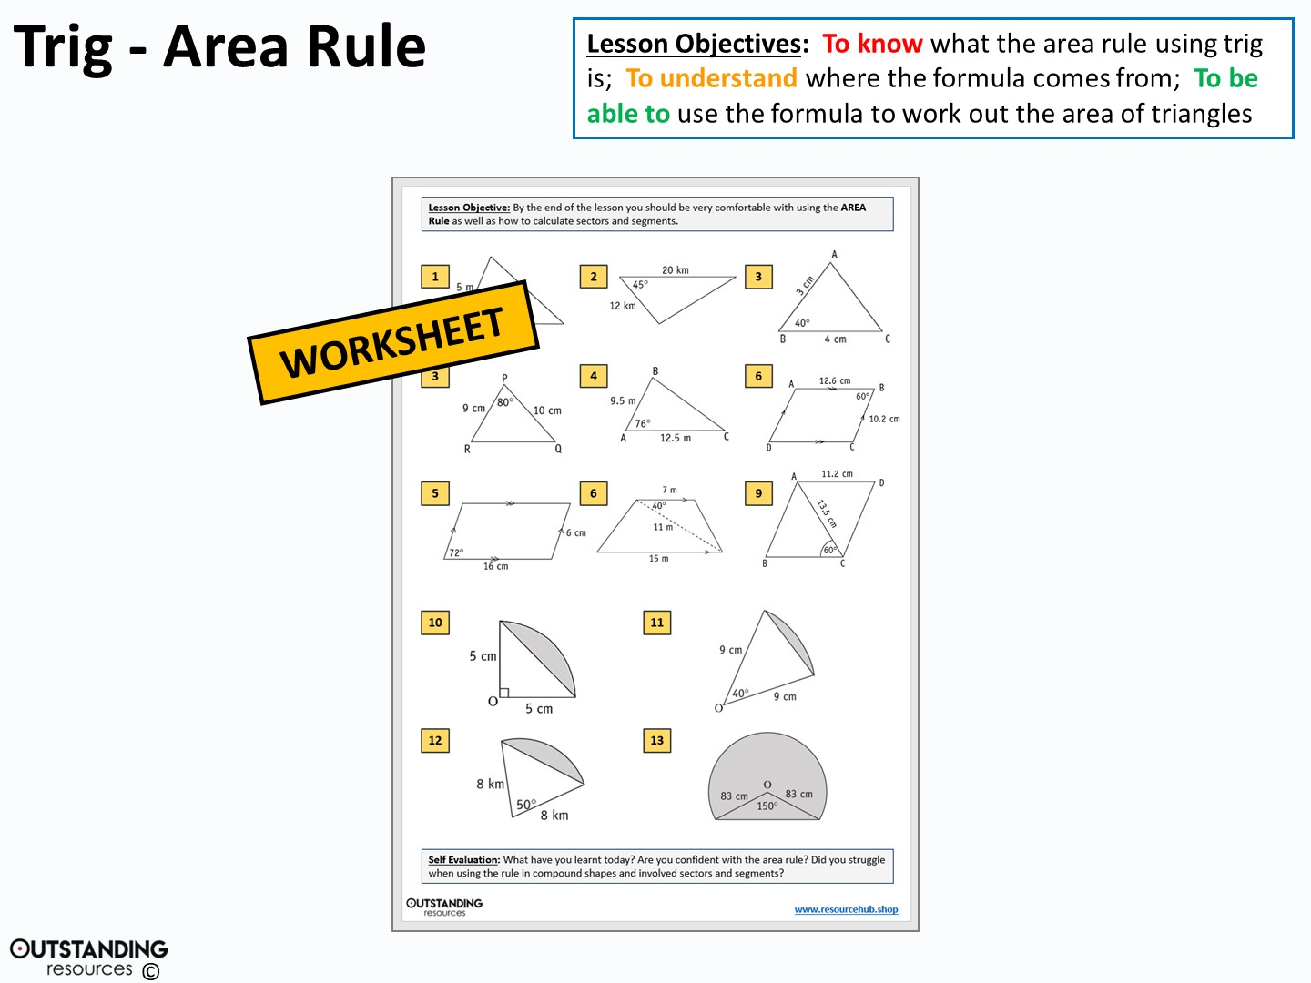

Slide 11
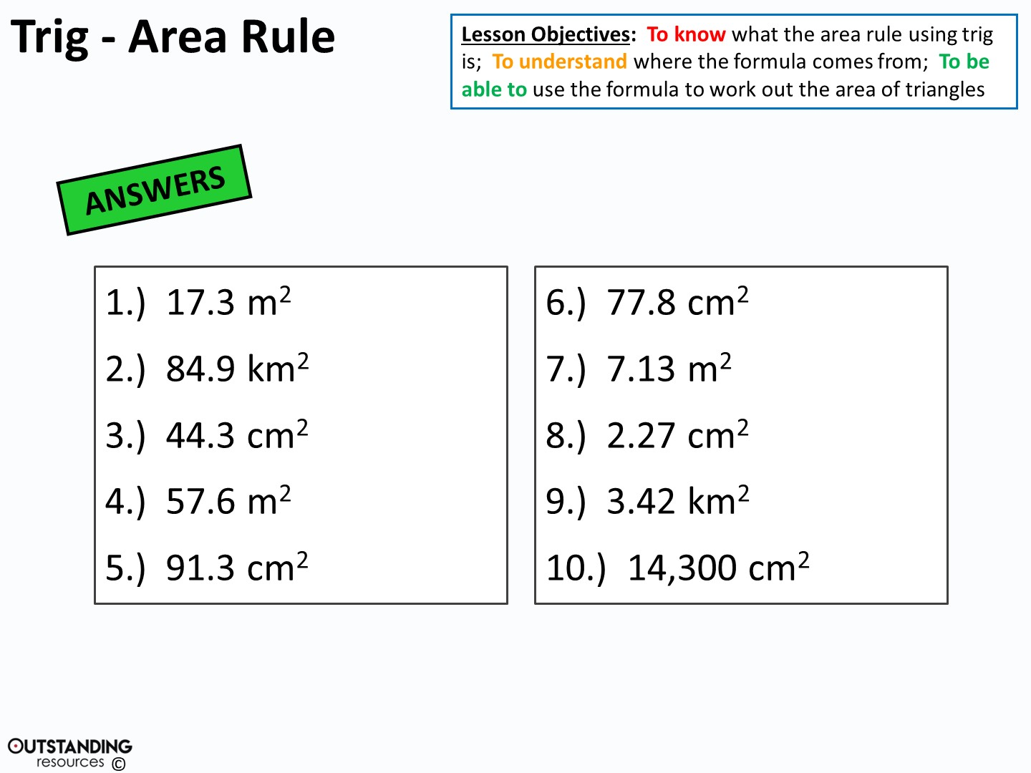

Slide 12
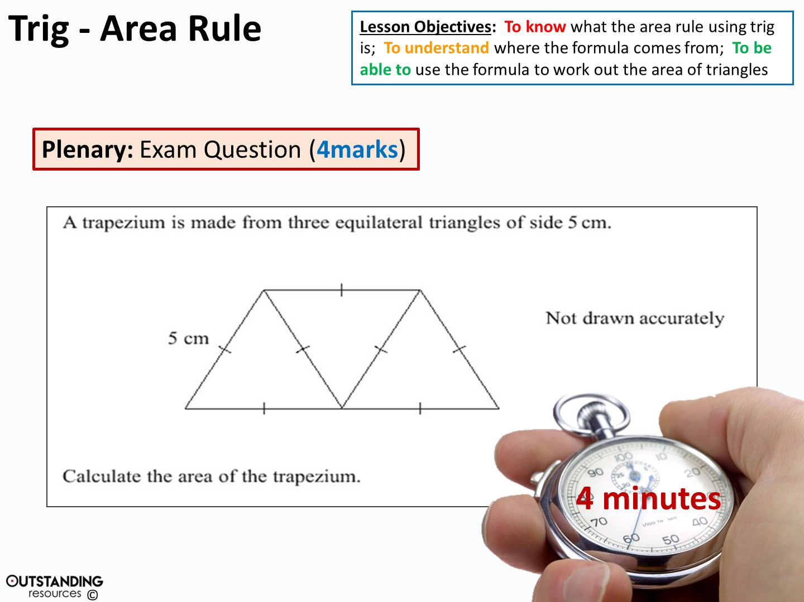
Notes:
Stop watch: taken from - https://www.flickr.com/photos/133046299@N03/26065725796/in/photolist-FHkEas-owcyQq-x7CFfr-NEDYNn-vBvpcX-65m1aJ-BPkRi8-PmYqqh-ziYXty-D2Mg3V-2exsSB-AZDGsA-x5eKg9-Hx9qQg-GBx2m9-9RSt1J-Hub933-KxnKih-vVKasq-Hx9pwe-Hx9qki-KWkMs7-KeaLNj-x5JTnA-CK9UVZ-KMnzv1-c2LFqN-awKby9-dcY8Sx-Ub6a2m-VqtSuF-d8EYR5-vB7KDq-xVExkw-enDhSt-BTMt8K-rQVH5i-w9BQsg-5sBuSW-wNUiHq-4fsVw-xmRcGg-9n7U7e-JR4v8C-wNUwhy-AJegJa-31fb1T-JXjse1-jRrEbV-x5JTTA/ http://creativecommons.org/licenses/publicdomain/

Slide 13
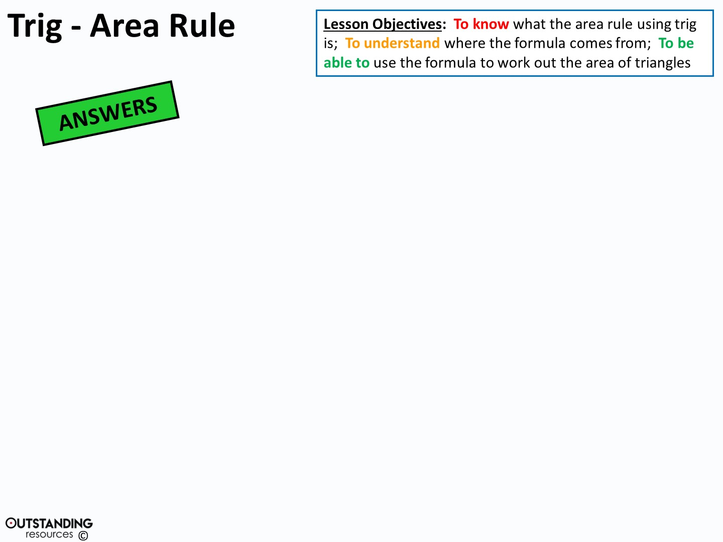
Method One:
Use Pythagoras to work out the height and then a triangle.
½ (5 x 4.330127…)
= 10.825 … X3
= 32.5cm² (to 3.s.f)
Method Two:
Use Pythagoras to work out the height
then the trapezium.
½ (5+10) x 4.330127…
= 32.5cm² (to 3.s.f)
5cm
h
2.5cm
h² = 5² – 2.5²
Method Three:
Use the area rule (½ abSinC)
= ½ (5)(5).Sin(60°) X3
= 32.5cm² (to 3.s.f)
h² = 18.75
h² = 4.330127 …

Slide 14
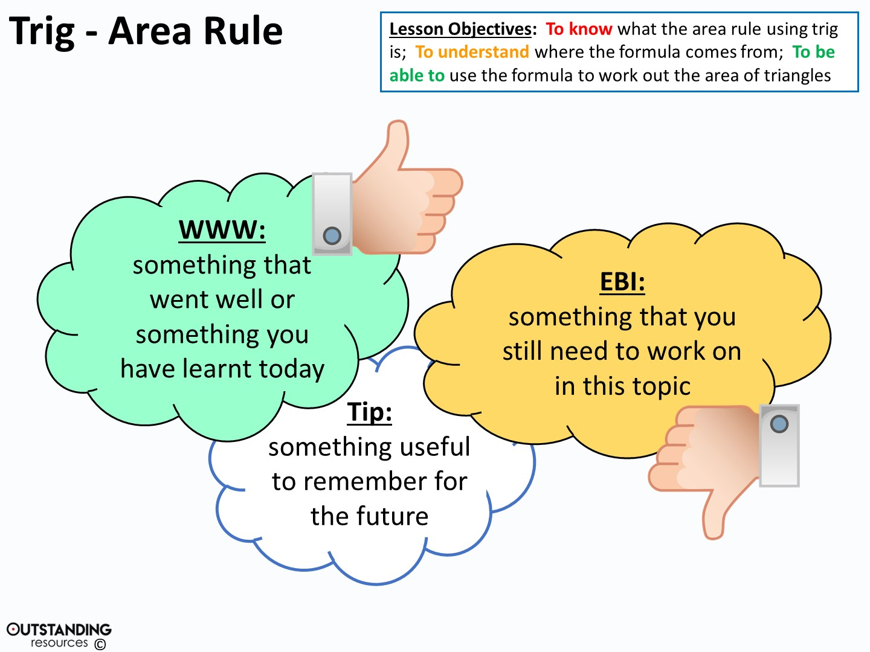
Notes:
Clipart - Thumbs Up Like Hand : taken from - https://openclipart.org/detail/241293/thumbs-up-like-handhttp://creativecommons.org/licenses/publicdomain/

Slide 15
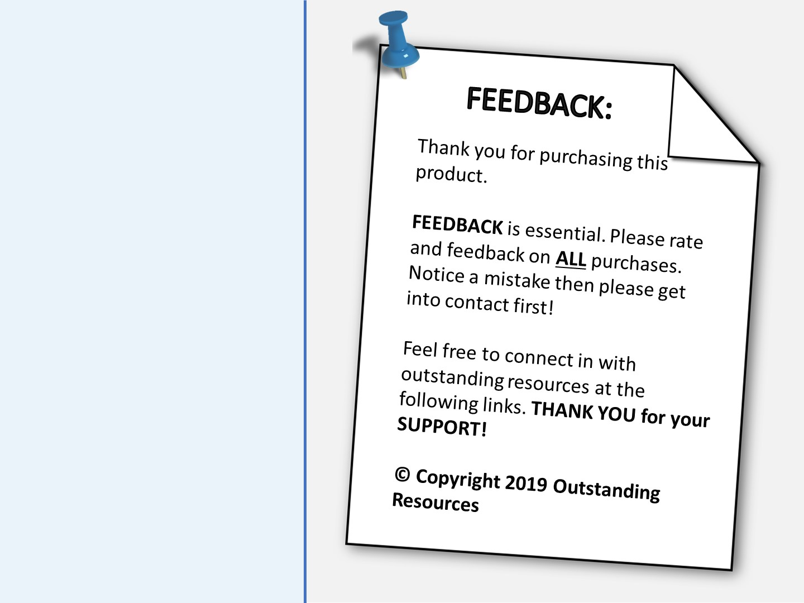




https://www.pinterest.com/outstandingresources/
https://www.facebook.com/orjust4u/
https://www.instagram.com/outstanding_resources/
Notes:
Pinterest Logo - By Pinterest - Pinterest, Public Domain, https://commons.wikimedia.org/w/index.php?curid=35304734
Clipart Image: Pin – taken from - https://openclipart.org/detail/31699/pin
Facebook Logo - By RomanLier - This file was derived from: Facebook logo thumbs up like transparent.png:Umberto NURS, CC BY-SA 4.0, https://commons.wikimedia.org/w/index.php?curid=38423808
Instagram Logo - By Instagram - Own work, Public Domain, https://commons.wikimedia.org/w/index.php?curid=48863359

Slide 16
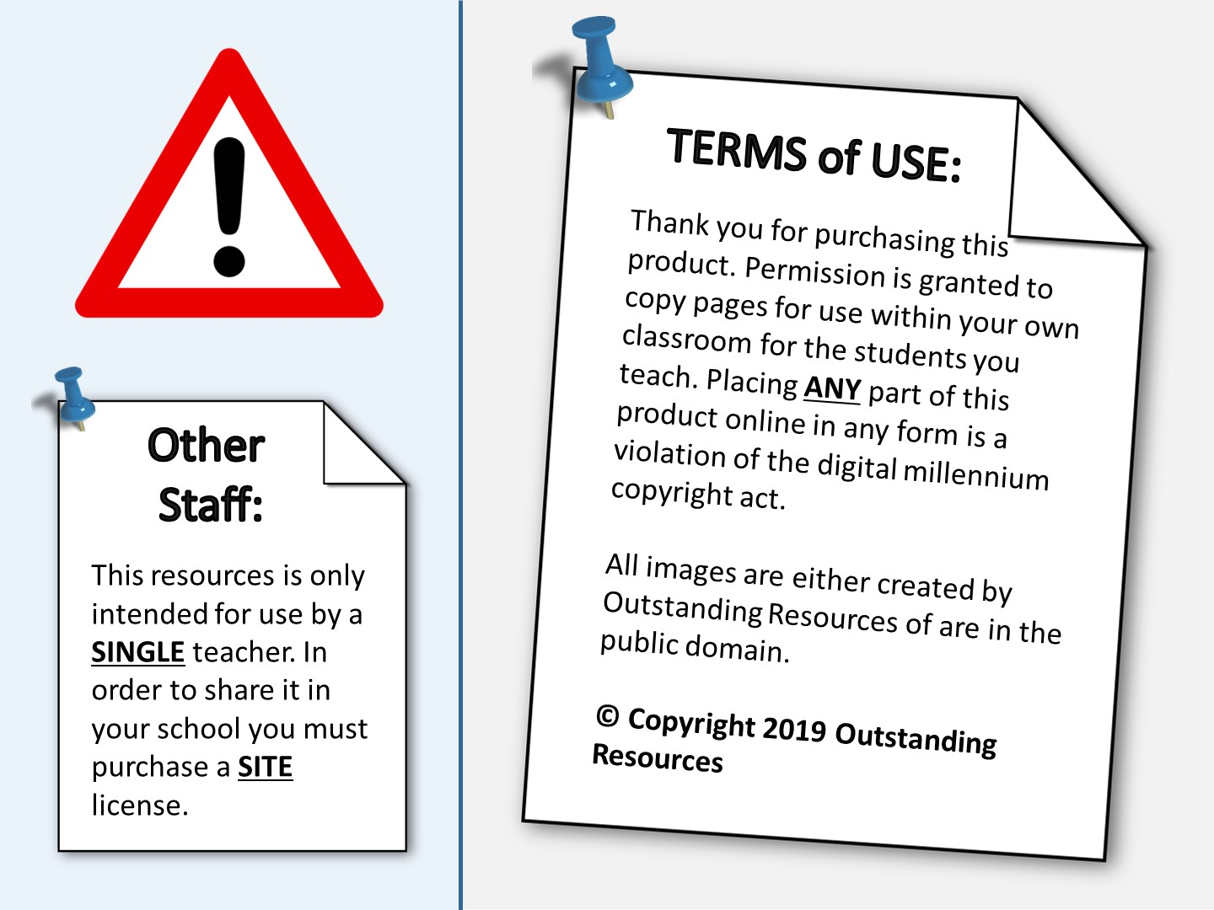
Notes:
Clipart Image: Pin – taken from - https://openclipart.org/detail/31699/pin
Clipart Image: Page – taken from - https://openclipart.org/detail/25850/file-diagram
Clipart Image: warning sign – taken from - https://openclipart.org/detail/48349/warning-sign

